Slide 1


Team Details
Case Study No. 4
Team Innovex
Tejaswi Jaddu (Team Leader) · Bichu Devnarayan
Indian Institute of Information Technology Kottayam

Slide 2


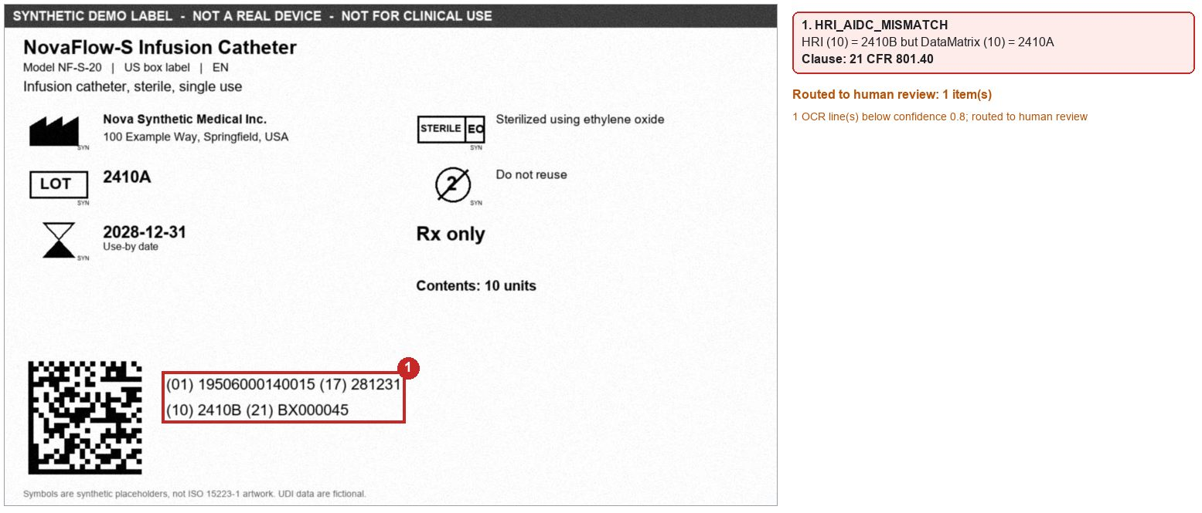
ClauseLink: every label element traced to the clause that requires it
The problem
Architecture: the graph is the system of record
Coverage of the 10 pain points (p.5)
A single product change may require updates to 30+ labels and 20+ languages (p.4).
Inputs: PLM and ERP data, regulatory sources, existing approved labels
Pain point
M0
M1
M2
M3
M4
M5
M6
WF
Causes of human error named in the case study (p.4):
Manual data entry and copying between ERP, PLM, labelling software and regulatory databases
Requirements that keep changing: UDI updates, new symbols, MDR changes
Reviewers comparing old versions, new versions and regulatory documents by hand
Translation inconsistencies; visual inspection that depends on people
1. Time-Consuming Manual Process
M2 Regulatory intelligence
Cited rule changes; RA approves them.
M0 Knowledge graph
M1 Change-impact engine
One query to every affected label.
Requirement
the clause that requires it
2. Frequent Regulatory Updates
Label element
LOT, UDI, warning, symbol
3. Symbol Management
4. Multiple Sources of Truth
M5 Authoring and translation
Approved phrases only; new text is a draft.
Source data
PLM or ERP attribute
M6 UDI-DI change detector
MDR Annex VI 3.9 triggers; US cases go to RA.
5. Expertise Dependency
Artwork
market, language, level
6. Manual Redlining
FDA device recall records with a labeling root cause
Approval
change order, e-signature
7. Repetitive Review
5.59%
of 59,481 records, all years
8. Traceability
3.95%
of 10,299 records, 2021 to 2025
M3 Compliance checker
Rules decide; LLM notes are flagged.
M4 CV verification
Printed UDI vs DataMatrix, symbols.
Human e-signature gate
RA and QA sign; AI never approves.
9. Variant Explosion
135 of 407
2021 to 2025 labeling records cite "Labeling Change Control"
10. Human Error
Source: openFDA device recall API, five labeling root-cause categories, data as of 2026-10-15. Records are per product; openFDA says to treat them as unvalidated.
● primary ○ supporting. M0 graph, M1 to M6 modules, WF workflow with e-signature and audit trail. Every pain point has a primary module.
Release: signed version, change order and audit trail written back to the graph
Prototype check
Synthetic test: 4/4 seeded defects caught, 0 false flags across 10 proofs; uncertain reads go to a human.
Shown: printed lot differs from the DataMatrix.
Process coverage
18-step flow plus a change trigger: 8 automated, 7 AI-assisted, 4 human (stakeholder review and 3 approvals).
Estimate: 42.9% to 88.1% less manual effort per change (48.5 to 225.5 h saved) for the 30-label, 20-language example. Assumptions in Annexure B.
Guardrails
AI never approves. RA and QA e-sign every release.
Part 11 audit trail: time-stamped record of every change (21 CFR 11.10(e)).
Risk-based review: full review for UDI, warnings and sterile data.
Validated as quality-system software (QMSR / ISO 13485, FDA CSA 2026).

Slide 3
Annexure A: Supporting detail, process map today and with ClauseLink
# | Today (case study, p.3) | With ClauseLink | Mode | Module
0 | (new) Change trigger | PLM/ERP change, approved rule change or new market opens a change record | Automated | M0, M2
1 | Product / Design Information | Connectors sync product attributes with source ID and version | Automated | M0
2 | Product Understanding | Attributes that drive requirements shown with their source; extracted values need owner confirmation | AI-assisted | M0
3 | Identify Applicable Markets | Read from registration and ERP data; RA confirms any new market | AI-assisted | M0
4 | Regulatory Requirement Assessment | Graph query returns the applicable clauses; new rules enter only after RA approval | AI-assisted | M0, M2
5 | Gap Assessment | Rule diff of required vs present elements, per label, market and level | Automated | M3
6 | Identify Labeling Gaps | Gap list with clause citations | Automated | M3
7 | Gap Addressal | Content proposed from the approved phrase library; the engineer accepts or edits | AI-assisted | M5
8 | Label Content Development | Label assembled from graph elements, no copy and paste | AI-assisted | M5
9 | Redline / Artwork Modification | Redline generated from the graph diff; layout changes proposed | AI-assisted | M5, M4
10 | Stakeholder Review | Risk-ranked packet: changed elements with clause, source and check results | Human | WF
11 | Regulatory / Quality Approval | Part 11 e-signature; AI never approves | Human | WF
12 | Label Revision | New version committed to the graph and linked to the approval | Automated | M0
13 | Change Order Creation | Drafted with the full impacted list; a person releases it | Automated | M1, WF
14 | Document / Configuration Control | The versioned graph is the configuration record, synced to PLM | Automated | M0
15 | Final Quality Check | CV checks the print proof; QA reviews every flag and signs | AI-assisted | M4, WF
16 | Label Release | E-signed release | Human | WF
17 | Manufacturing | Released files go to the existing print system; CV checks samples | Automated | M4
18 | Production Implementation | Line clearance and first-article sign-off with CV evidence | Human | WF
Count: 8 automated, 7 AI-assisted with a human check, 4 human, over the 18 steps plus the new change trigger. Steps 4 and 9 mix automated and AI-assisted work and are counted as AI-assisted. Stakeholder review and the three approvals (11, 16, 18) stay human.

Slide 4
Annexure B: Supporting detail, automation opportunity matrix and impact model
# | Step | Effort | Error risk | Automation | Priority | Module
1 | Product / Design Information | 2 | 3 | 3 | 8 | M0
2 | Product Understanding | 2 | 2 | 2 | 6 | M0
3 | Identify Applicable Markets | 1 | 2 | 2 | 5 | M0
4 | Regulatory Requirement Assessment | 3 | 3 | 2 | 8 | M0, M2
5 | Gap Assessment | 3 | 3 | 3 | 9 | M3
6 | Identify Labeling Gaps | 2 | 3 | 3 | 8 | M1, M3
7 | Gap Addressal | 2 | 2 | 2 | 6 | M5
8 | Label Content Development | 3 | 3 | 2 | 8 | M5
9 | Redline / Artwork Modification | 3 | 2 | 3 | 8 | M5, M4
10 | Stakeholder Review | 3 | 2 | 2 | 7 | WF, M3
11 | Regulatory / Quality Approval | 2 | 2 | 1 | 5 | WF
12 | Label Revision | 1 | 2 | 3 | 6 | M0
13 | Change Order Creation | 2 | 2 | 3 | 7 | M1
14 | Document / Configuration Control | 2 | 2 | 3 | 7 | M0
15 | Final Quality Check | 3 | 3 | 3 | 9 | M4
16 | Label Release | 1 | 2 | 1 | 4 | WF
17 | Manufacturing | 2 | 3 | 2 | 7 | M4
18 | Production Implementation | 2 | 2 | 1 | 5 | WF
Impact model: one change, 30 labels × 20 languages (estimate)
Assumption | Base | Pessimistic
Today: impact assessment | 16 h | 8 h
Today: redline per label | 2 h | 1 h
Today: review per language block | 5 min × 3 reviewers | 3 min × 2 reviewers
Today: final check per label | 1 h | 0.5 h
ClauseLink: RA confirms impact list | 0.5 h | 2 h
ClauseLink: layout check per label | 0.25 h | 0.5 h
ClauseLink: diff-only packet per label | 10 min × 2 | 20 min × 2
ClauseLink: flagged blocks reviewed | 10% at 5 min | 25% at 5 min
ClauseLink: QA review of CV evidence | 0.25 h per label | 0.5 h per label
Case | Today | ClauseLink | Saved
Base | 256 h | 30.5 h | 225.5 h (88.1%)
Pessimistic ClauseLink side | 256 h | 64.5 h | 191.5 h (74.8%)
Pessimistic on both sides | 113 h | 64.5 h | 48.5 h (42.9%)
Every label is assumed to carry all 20 languages: 600 language blocks. Effort only. Elapsed time depends on approval queues and is not claimed; error rates and real timings come from a pilot audit trail.
Scores 1 (low) to 3 (high) are team estimates from the p.5 pain points, not measurements. Priority is the sum (maximum 9). Steps 5 and 15 score highest.

Slide 5
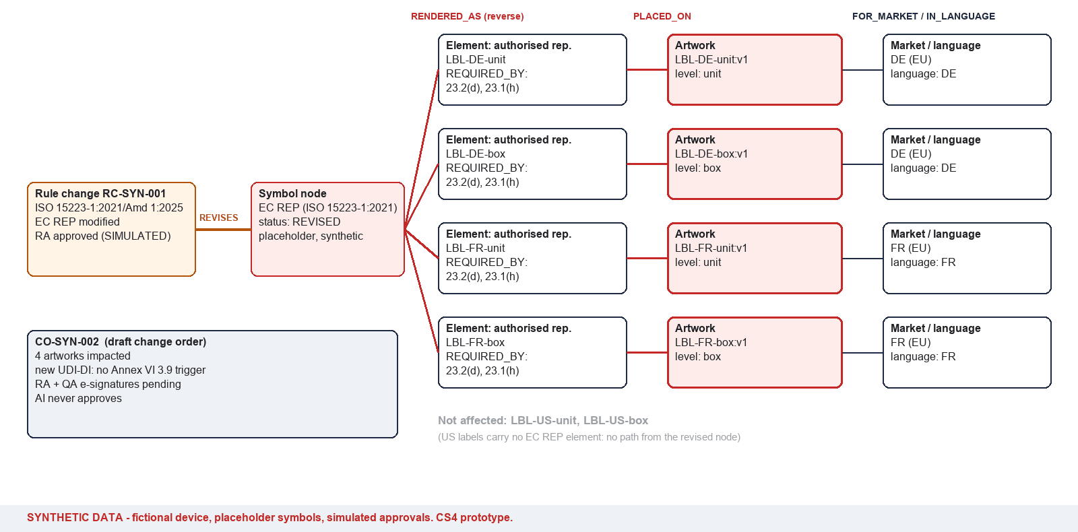
Annexure C: Supporting detail, prototype on synthetic data
Scenario 1: ISO 15223-1 Amd 1 changes the EC REP symbol; one graph query finds the 4 affected labels
Scenario 3: seeded-defect proofs
Proof | Seeded defect | Finding | Clause
(a) US-box | Lot in the human-readable UDI (2410B) differs from the DataMatrix (2410A) | Printed UDI differs from DataMatrix | 21 CFR 801.40
(b) US-unit | 'Rx only' missing on the US label | Required element missing | 21 CFR 801.109(b)
(c) DE-unit | Old EC REP placeholder (pre-Amd 1) still used | Symbol edition outdated | MDR Annex I 23.1(h), 23.2(d)
(d) FR-box | MD symbol (and its caption) missing on an EU label | Required element missing | MDR Annex I 23.2(q)
4/4 seeded defects caught. 0 false defect flags across 10 proofs (4 seeded, 6 clean controls). 3 uncertain OCR reads were routed to a human: twice the small "SYN" tag on a placeholder symbol, once an address read just under the 0.80 confidence threshold.
Scenario 2 (pack quantity 10 to 5): 3 box labels affected; new UDI-DI flagged for DE and FR under MDR Annex VI 3.9(f); US routed to RA, with a GUDID task under 21 CFR 830.310(b)(14).
Limits of this test
Symbol templates are drawn by the same code that renders the labels, so matching is easier than on real artwork.
No rotation, no real ISO artwork, no print-quality grading. Proofs are blurred, noised and JPEG-compressed only.
All data are synthetic: fictional device, company and GTINs, placeholder symbols, simulated approvals. n = 4 seeded defects is a smoke test, not a validation result.

